Slide 1

Knapsack Cryptosystem
Copyright © The McGraw-Hill Companies, Inc. Permission required for reproduction or display.
10.<number>

Slide 2
10.1.5 Knapsack Cryptosystem
Definition
a = [a₁, a₂, …, a_{k} ] and x = [x₁, x₂, …, x_{k}].
Given a and x, it is easy to calculate s. However, given s and a it is difficult to find x.
Superincreasing Tuple
a_{i} ≥ a₁ + a₂ + … + a_{i−1}
10.<number>

Slide 3
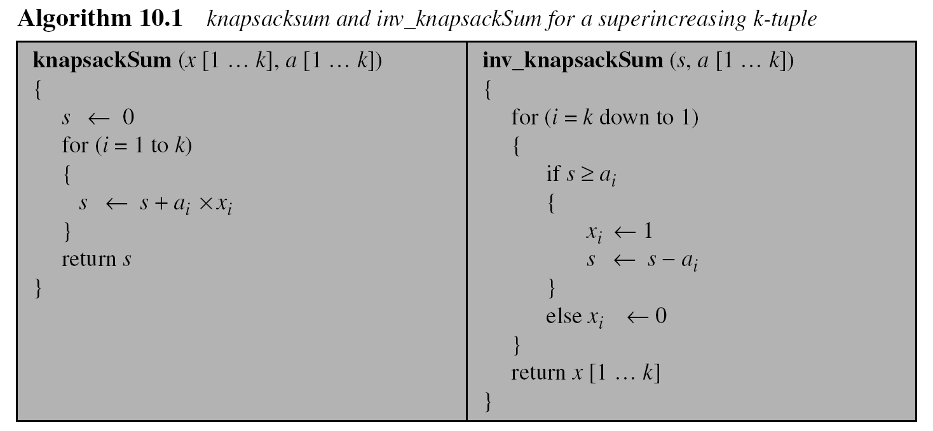
10.1.5 Continued
10.<number>

Slide 4
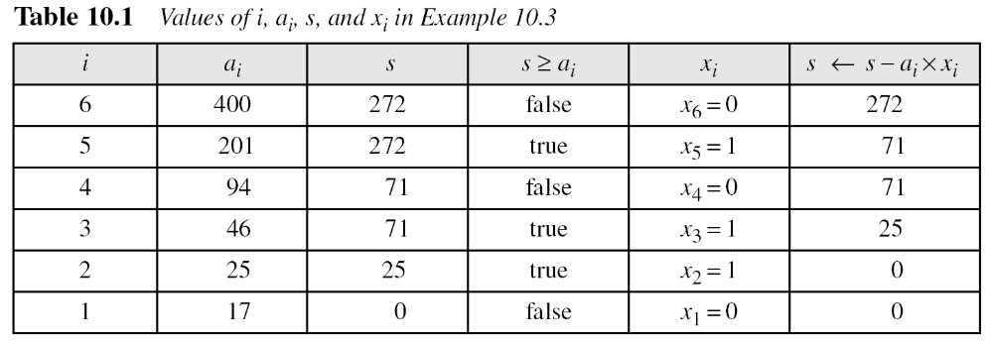
10.1.5 Continued
Example 10. 3
As a very trivial example, assume that a = [17, 25, 46, 94, 201,400] and s = 272 are given. Table 10.1 shows how the tuple x is found using inv_knapsackSum routine in Algorithm 10.1. In this case x = [0, 1, 1, 0, 1, 0], which means that 25, 46, and 201 are in the knapsack.
10.<number>

Slide 5
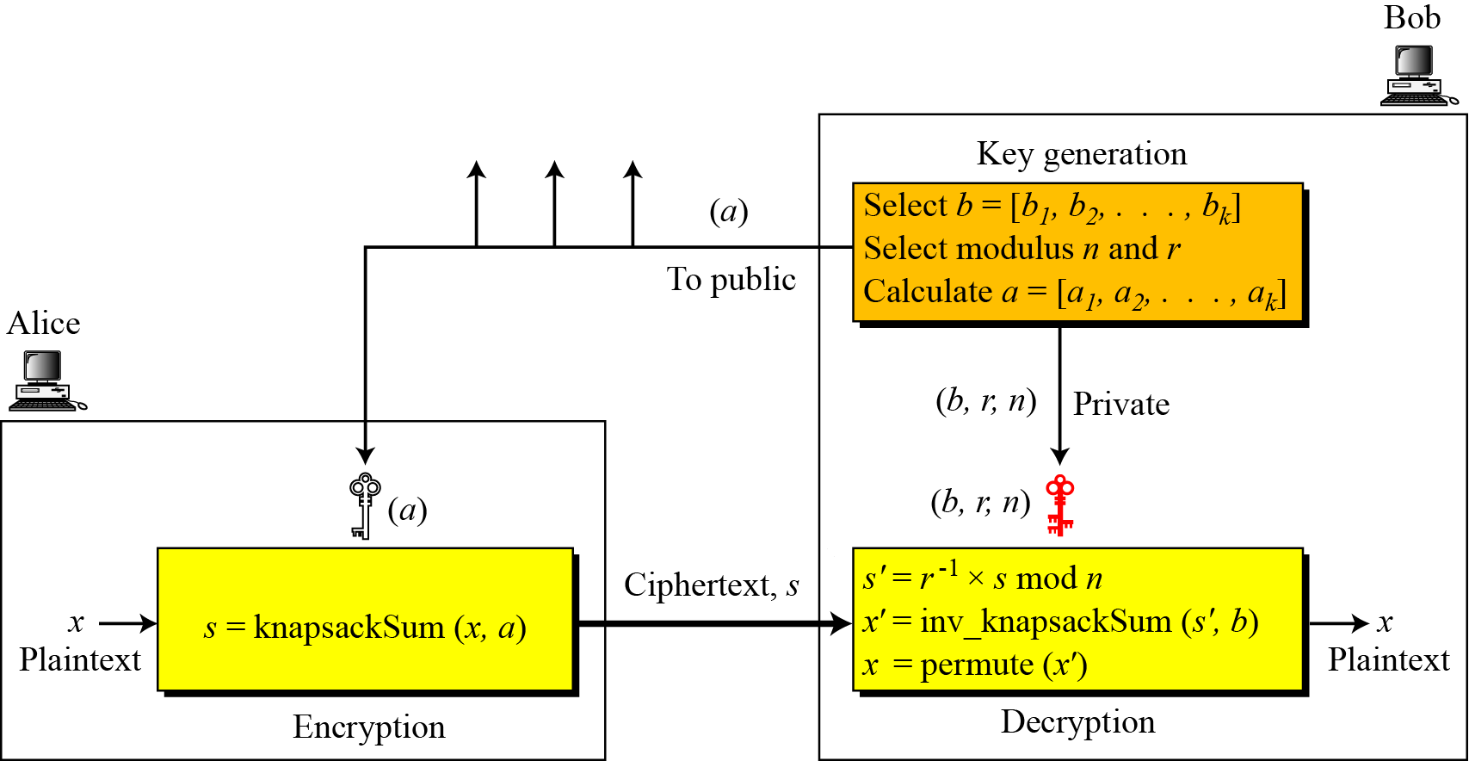
10.1.5 Continued
Secret Communication with Knapsacks.
Figure 10.4 Secret communication with knapsack cryptosystem
10.<number>

